Slide 1



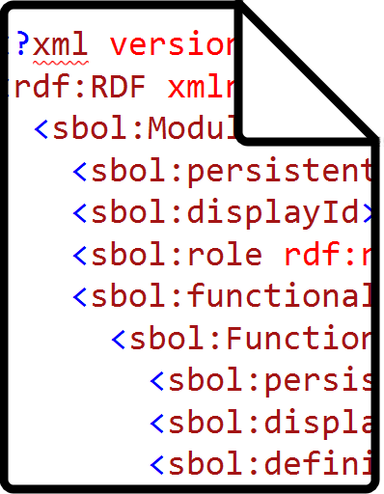
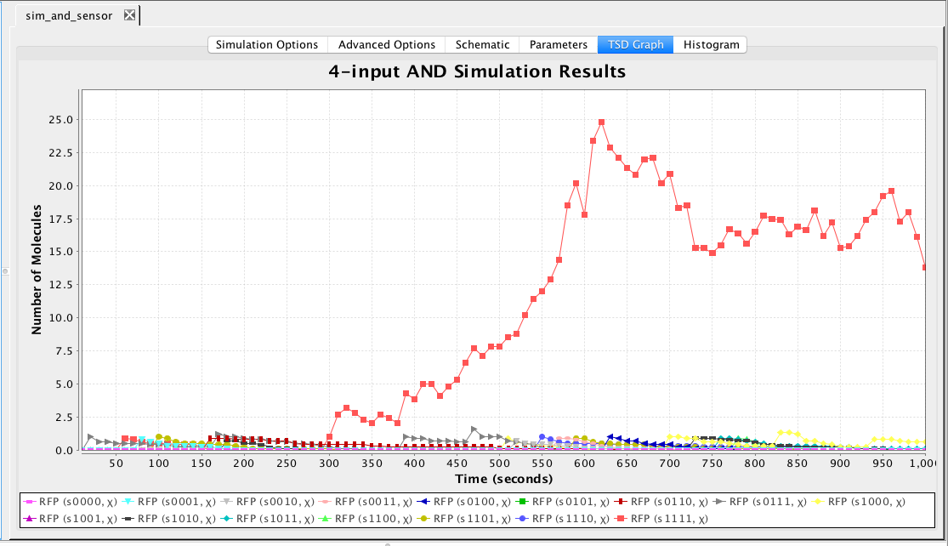


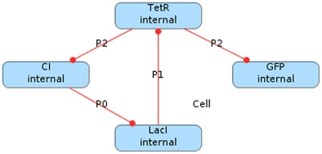





Parts Repositories
Circuit CAE
SBOL
Cello, iBioSim
Sequence CAD
SBOL Designer, DNAplotlib

Slide 2
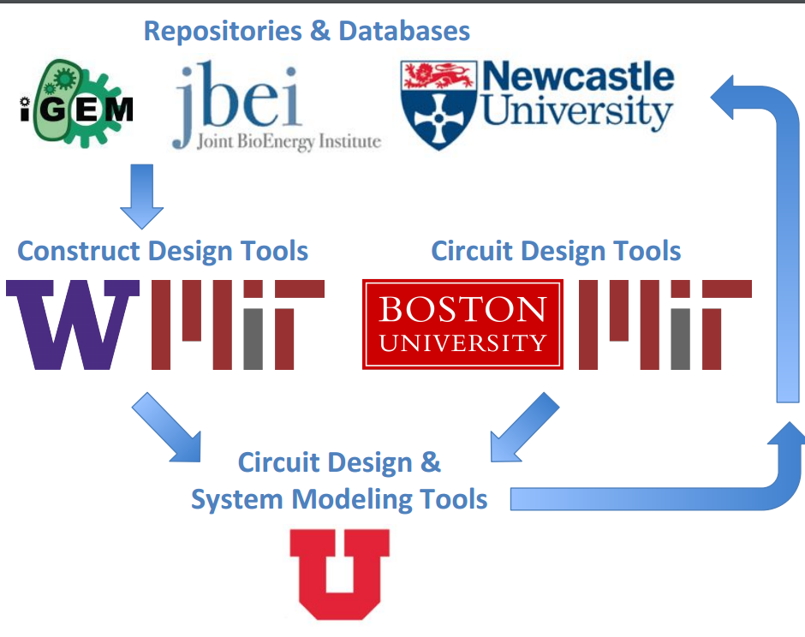

Slide 3
